Slide 1
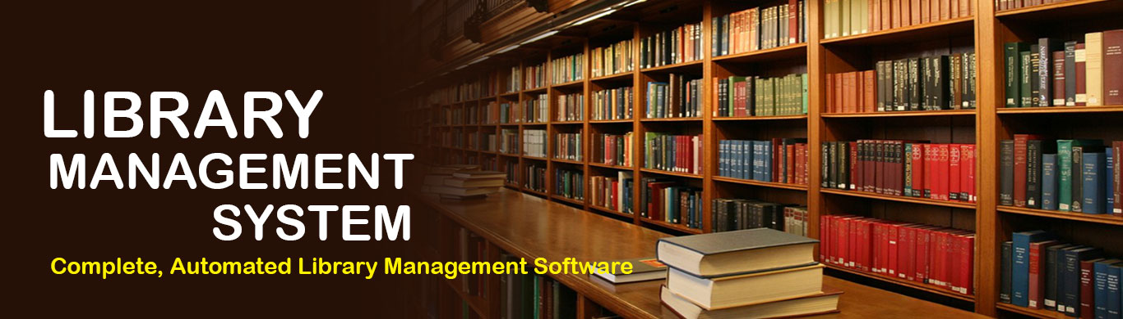

Developed By –
Pranali Patyane

Slide 2
Contents
Objectives
Software Requirement
Flow Diagram
Login Result
Future Enhancement
Conclusion

Slide 3
Objectives
To manage the details of Books, Students and Librarian
The system contains database where all the information will be stored safely
It deals with monitoring the information and transactions of book issues and submit books
Provides the searching facilities based on various factors such as books

Slide 4
Software Requirement
Software Languages :
Python –
- Oops
- Regular Expression
Python Libraries –
- Pandas
- Maskpass
Mysql –
- CRUD Operations
- TCL
Software Platform –
- Visual Studio Code
- Python pip Version
- Command Prompt

Slide 5
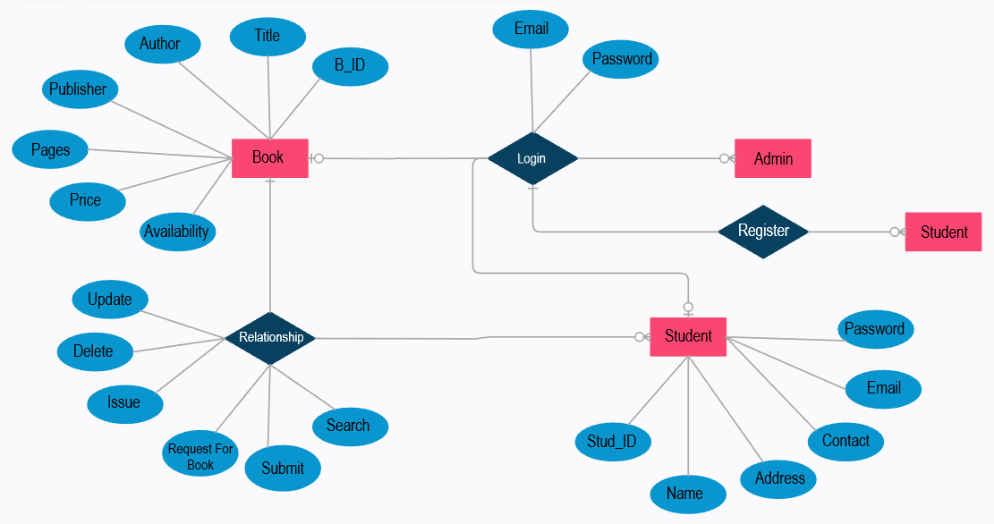
Flow Diagram

Slide 6
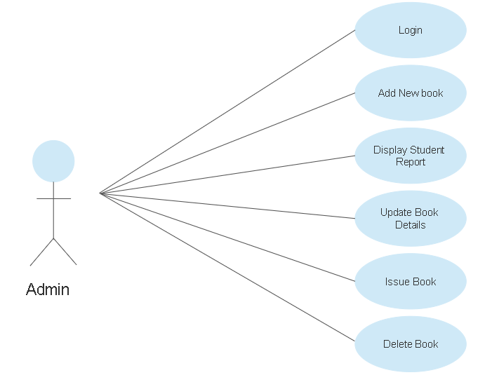
Admin Flow Diagram

Slide 7
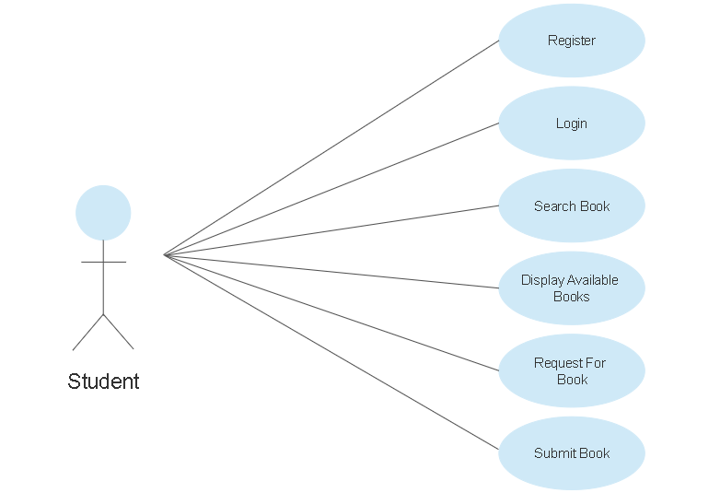
Student Flow Diagram

Slide 8
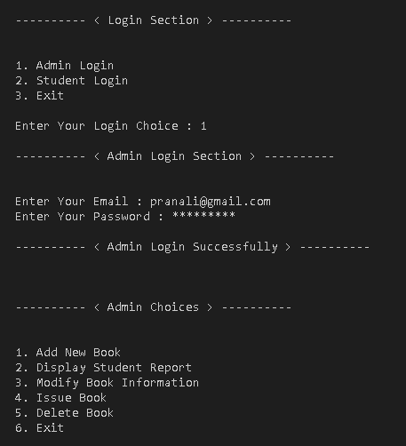
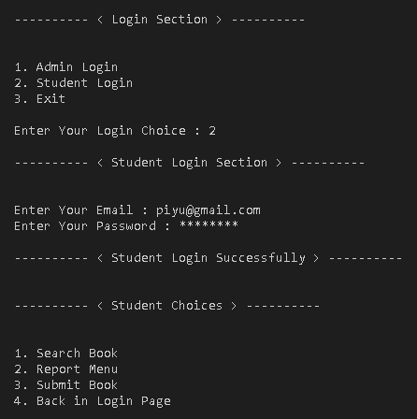
Login Result
Admin Login
Student Login

Slide 9
Future Enhancement
In adding the more features of online library management system to develop access with user’s flexibility
Many users can login at the same time
Get notification via mail
Make an online chat facility for student and developer interaction

Slide 10
Conclusion
The software allows storing the details of all the data related to library
The implementation of the system will reduce data entry time and provide readily calculated reports
The software takes care of all the requirements of an a library and is capable to provide easy and effective storage of information related to books and users

Slide 11
Thank you

